Slide 1
Risk Managing
Acute Ionising Radiation Exposure
Dr David J Heslop

Slide 2
Radiation Hazards
Non-ionising:
  Electromagnetic spectrum
Ionising:
  Alpha
  Beta
  Gamma
  Neutron
  X-radiation

Slide 3
Routes of Exposure
Direct exposure (line of sight)
Secondary exposure:
  Inhalation
  Ingestion
  Contamination of skin
  Penetrating traumatic wounds (radioactive shrapnel)

Slide 4
Sources
Line of sight from radioactive object
Degradation products (dust, fragments) from radioactive object
Incorporation into day to day substances (food chain, water supply)
Induced radioactivity (coupling)
Contamination (fallout, dispersal)

Slide 5
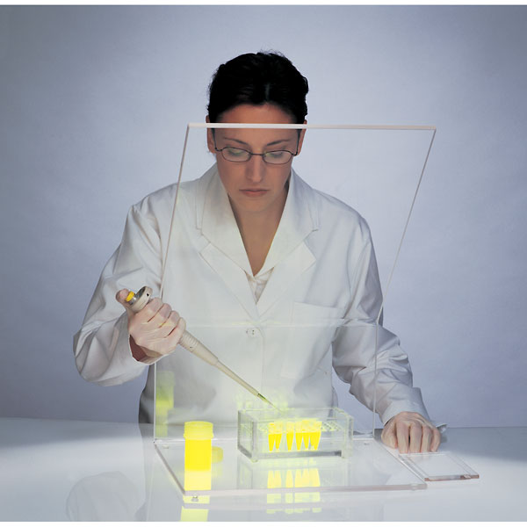
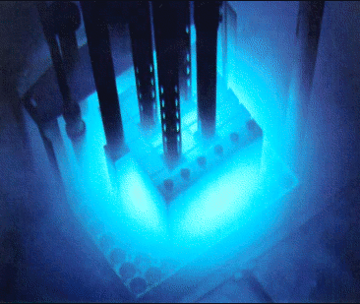
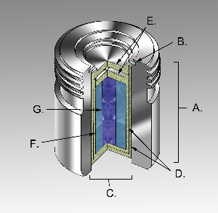
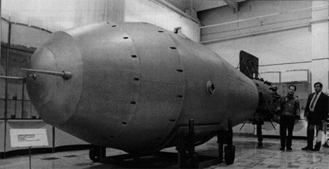
Radiological Agents
The University Seven:
  ³H, ¹⁴C, ³²P, ⁶⁰Co, ¹²⁵I, ¹³¹I, ²⁵²Cf
  Isotope labelling/Research purposes (e.g. biochemistry)
The Industrial Three:
  ¹⁹²Ir, ¹³⁷Cs, ⁶⁰Co
  Industrial scale X-Rays, Food Sterilisation
The Military Four:
  ³H, ²³⁵U, ²³⁹Pu, ²⁴¹Am
  Nuclear Weapons Development and Manufacture
Universities and Research Organisations
Industry
Nuclear weapons R&D, manufacture and maintenance

Slide 6
Radiation/Radioactivity
Becquerel (Bq) is SI unit for activity
  1 Bq = 1 disintegration/second
Gray (Gy) is the SI unit for energy absorbed per kg
  1 Gy = 1 J/kg
Sievert (Sv) is the SI unit for biological effect/equivalent dose.
  Accounts for different tissue sensitivities to radiation
  Accounts for different susceptibilities to radiation types
  1 Gy of whole body gamma irradiation = 1 Sv
  RBE (Sv) = weighting factor x Dose (Gy)

Slide 7
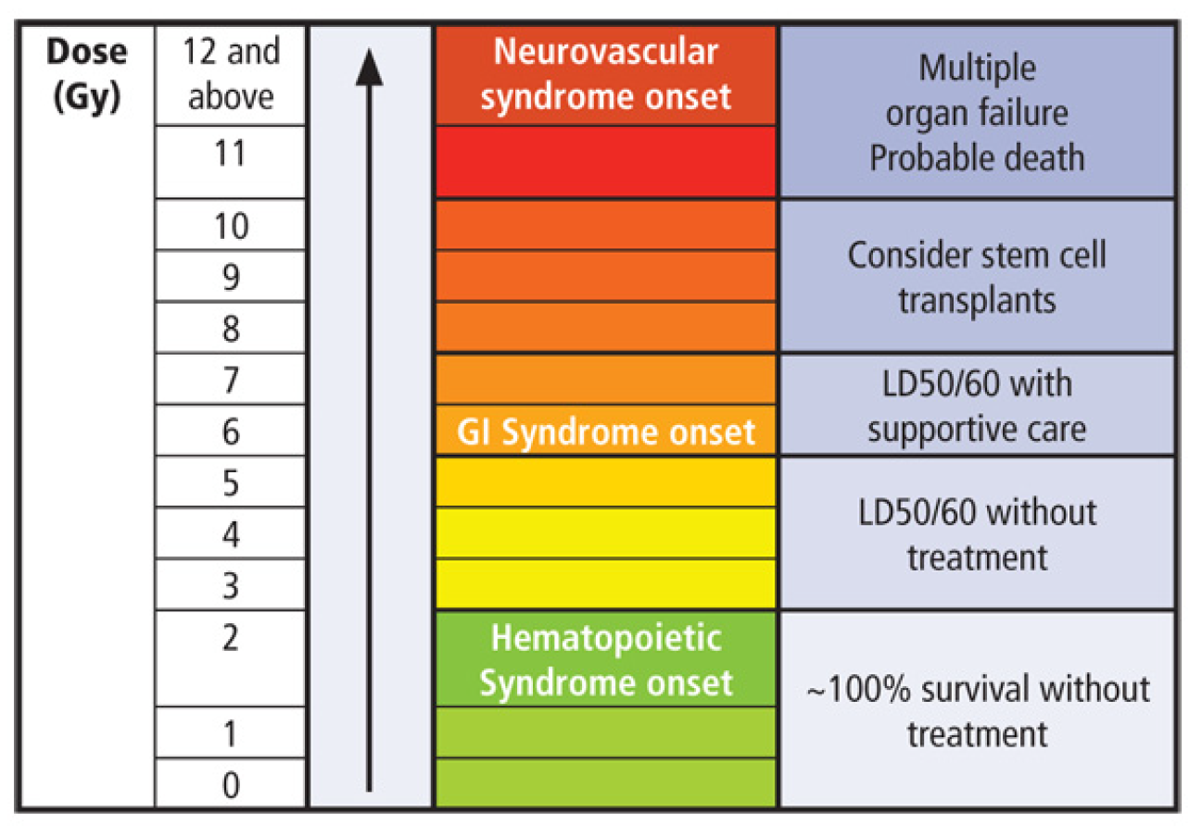
Acute Radiation Sickness
< 1 Gy = no illness, biochemical change
> 1 Gy = Haemopoietic Syndrome
> 6 Gy = Gastrointestinal Syndrome
> 10 Gy = Neurovascular Syndrome

Slide 8
Toxicology
LD_{50/60} = 4.1 Gy (95% confidence interval 2.55 - 5.5)
Similar results in animals
Does not factor heavy metal toxicity
Anno et al 2003, Health Phys. 84(5):565–575; 2003

Slide 9
Phases of Illness
Prodrome
  Initial symptoms
  Within 24 hours
  Vomiting, nausea, diarrhoea
Latent
  Resolution of symptoms for up to 3 weeks
Manifest
  Risk of sepsis, overwhelming infection, comorbidities
  Bleeding risk - thrombocytopaenia
Resolution/Death
  By 3 months

Slide 10
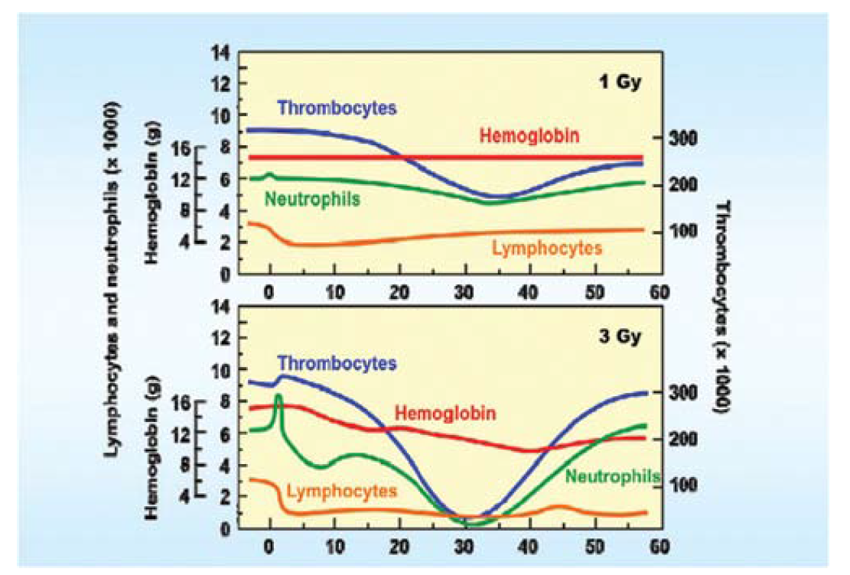

Slide 11
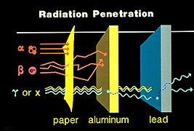
Risk Controls - Traditional
Inverse Square Law
Time
Distance
Shielding

Slide 12
TYPE | RANGE | SHIELDING | COMMON SOURCES
Alpha (α) | very short (non-penetrating) | dead skin layer sheet of paper | U-235, Am-241
Beta (β) | short (non-penetrating) | Clothing aluminium | H-3, C-14, Sr-90 (pure β emitters)
Gamma (γ) X-ray | penetrating | lead, concrete | Cs-137, Co-60, Ra-226 Tc-99m
Neutrons | penetrating | layers of material made of light nuclei eg. water, bricks | Am-Be, Cf-252 (fission) U-235 (fission)

Slide 13
Consequence Management - Traditional
Decontamination (?wounds)
Prophylactics:
  Potassium Iodide (only for iodine)
  Prussian Blue (only for Caesium)
Decorporation:
  Zn and Ca – DTPA (some isotopes only)
  Diuresis (some isotopes only)
Various other methods (dimercaprol etc)

Slide 14
Neulasta (pegfilgrastim)
Neupogen (filgrastim)
Filgrastim = recombinant methionyl human granulocyte colony stimulating factor (r-metHuG-CSF)
Produced in E.Coli (recombinant)
On label use:
  treatment of neutropaenia secondary to chemotherapy
  Stimulation of haematopoietic stem cells before leukapheresis (for stem cell transplantation)
Side effects:
  Common: Mild to moderate bone pain
  Serious: allergic reaction, splenic rupture, alveolar haemorrhoage, ARDS, haemoptysis, sickle cell crisis, GN
Subcutaneous injection (6mg) prefilled syringe x1
Neulasta is pegylated (slow release) variant of Neupogen

Slide 15
Effectiveness in ARS
Significant improvement in survival in a number of animal models:
  Rhesus macaques
  Pigs
  Small animals
LD50 increases to approximately 7 Gy with G-CSF and to 9 with intensive care treatment
Coupled with stem cell transplantation, further increases in LD50 seen (>10 Gy)
  Other radiation related comorbidities become important at that point

Slide 16
Summary
Measures can be put in place for radiation workers to decrease risk of ARS
These have been shown to be clinically effective and safe
  G-CSF
  Stem cell transplant
For high risk activities, they are cost effective

